Slide 1


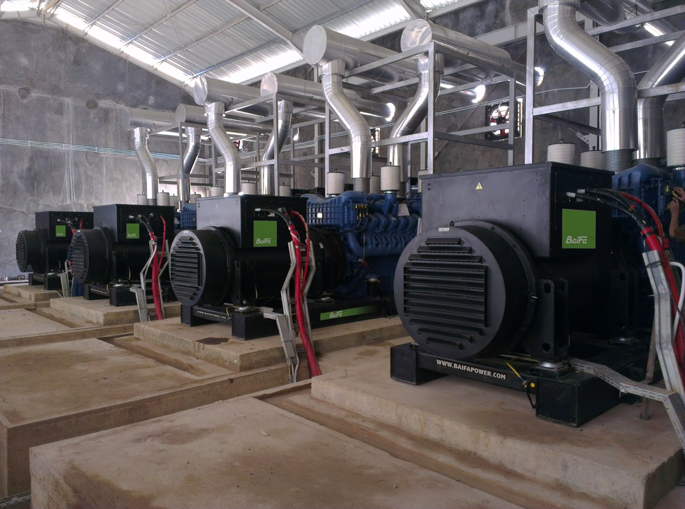

Notes:
WELCOME to BAIFA.
Thank you for joining us today.
It is my pleasure to introduce BAIFA and share with you our capabilities in power generation solutions.

Slide 2
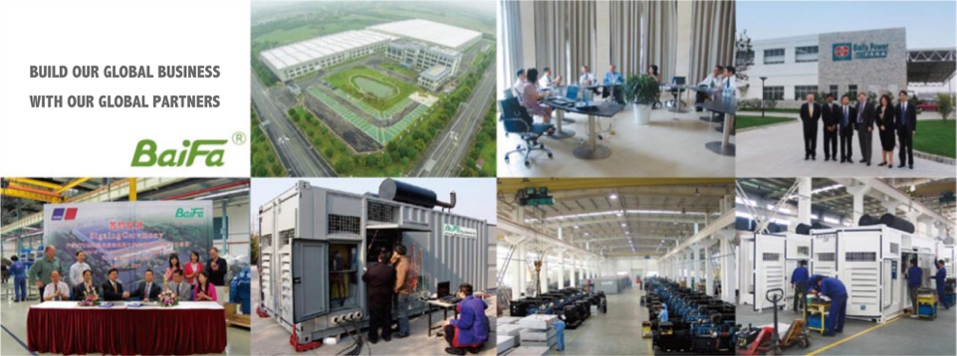

WELCOME TO BE PART OF BAIFA TEAM
Notes:
IN THE PAST 34 years, Baifa build our global business together with our global partners, empowering our partners is our goal, our mission together to make energy more Accessible, Reliable and Sustainable.

Slide 3
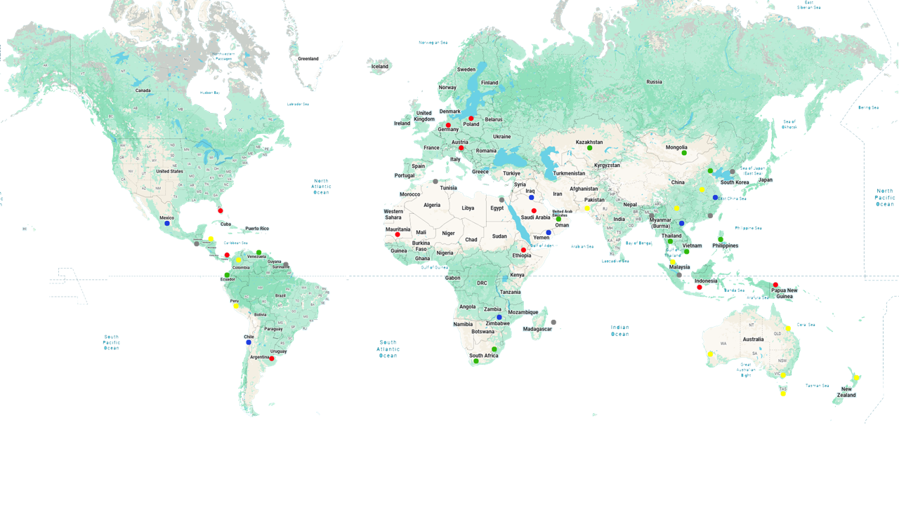
GLOBAL DISTRIBUTOR NETWORK
Notes:
BAIFA's strength lies in our extensive global distributor network. With partners across 5 continents, we deliver localized power solutions while maintaining international quality standards.

Slide 4

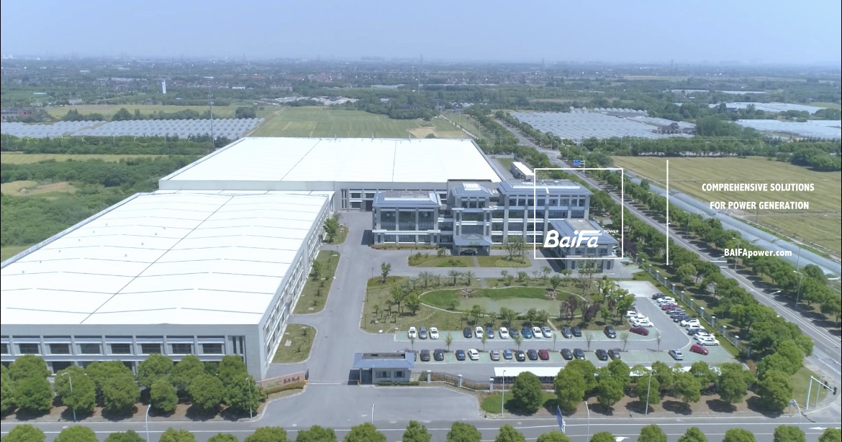
BAIFA, headquartered in the Wuxi National High-Tech Industrial Development Zone, owns one of the largest generating set manufacturing bases in Asia.
With over 33 years of experience, Baifa has dedicated itself to the development and manufacture of power generation products and tailored services, offering "one-stop" comprehensive solutions.
Notes:
Headquartered in Wuxi National High-Tech Zone, BAIFA operates Asia's largest generator manufacturing base. With 34 years of expertise, we specialize in 'one-stop’ comprehensive power solutions.

Slide 5
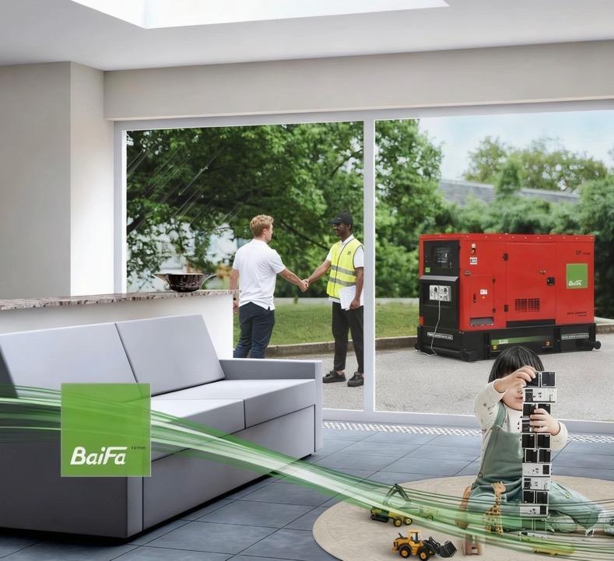
Our MISSION ARS is to deliver
ACCESSIBLE, RELIABLE & SUSTAINABLE
‘ONE STOP’ comprehensive power generation anywhere on our planet together with our extensive global network.
ACCESSIBLE
We are committed to
enhancing efficiency of management, production & service,
aiming to reduce capital and operational expenditures
associated with owning BF power generators.
RELIABLE
We are committed to
continuing innovating for solutions, and
strive to maximize generator capabilities & flexibilities to adapt to diversified applications & environments.
SUSTAINABLE
Integrating leading technologies to
minimize energy consumption and COx/NOx emissions
for every kilowatt-hour produced from our product,
safeguarding our precious natural environment.
OUR MISSION ARS
Notes:
Our mission is deliver:
Accessible: Optimizing management efficiency and global network to reduce total generator ownership costs
Reliable: Continuous innovation for adaptable generator capabilities
Sustainable: Minimizing operational cost, emissions and fuel consumption through leading-edge technologies
These pillars drive our commitment to accessible, reliable and sustainable power anywhere on Earth.

Slide 6




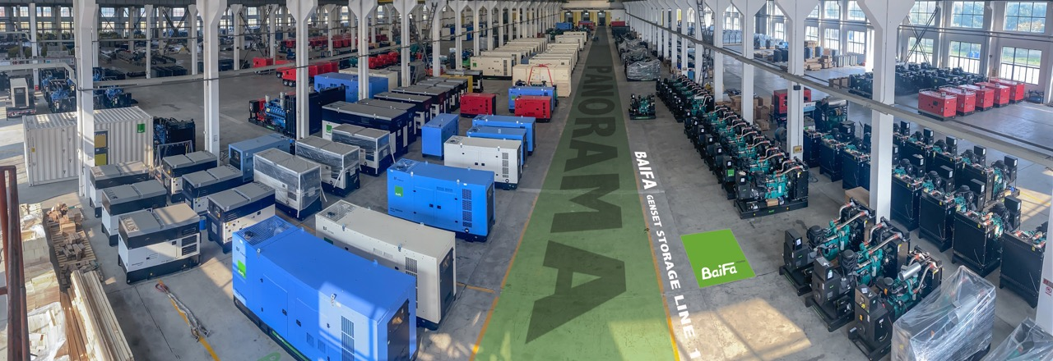


PRODUCT RANGE:
-Industrial diesel and gas generator sets range from 8kW to 3200KW.
-Marine generator set from 40kW to 1100kW
-4 types of lighting towers
-LV&HV SWITCH PANEL up to 35kV
-TRANSFORMERS up to 110kV
-POWER GENERATION ACCESSORIES
OUR PRODUCT RANGE
Notes:
Our comprehensive range includes:
• Industrial diesel/gas generators (8-3200kW)
• Marine generators (40-1100kW)
• Lighting towers (4 types)
• LV/HV switch panels (up to 35kV)
• Transformers (up to 110kV)
• Generator accessories

Slide 7
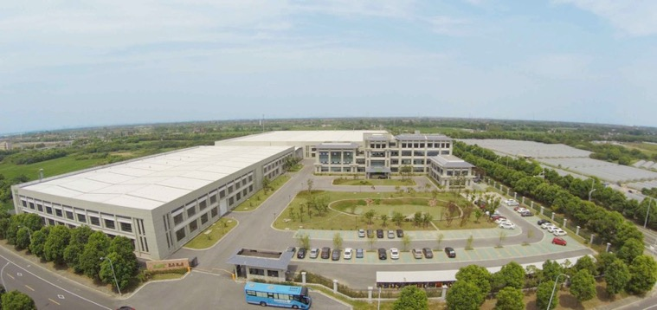
BAIFA GROUP
BAIFA POWER (WUXI) LTD.
HUAXUN EMERGENCY EQUIPMENT LTD.
BAIFA INTERNATIONAL ENGINEERING
TITLIS POWER ENGINEERING (SINGAPORE)
OUR GROUP
Notes:
BAIFA Group comprises specialized entities including BAIFA Power (Wuxi), Huaxun Emergency Equipment, and international engineering divisions. Our Singapore subsidiary, Titlis Power, exemplifies our global reach.
BAIFA GROUP
- Baifa power wuxi for main R&D, manufacturer activities and trading.
- Titlis power Singapore for overseas origin generator units
Baifa power international for engine import and trading
Baifa power engineering for EPC and rental

Slide 8
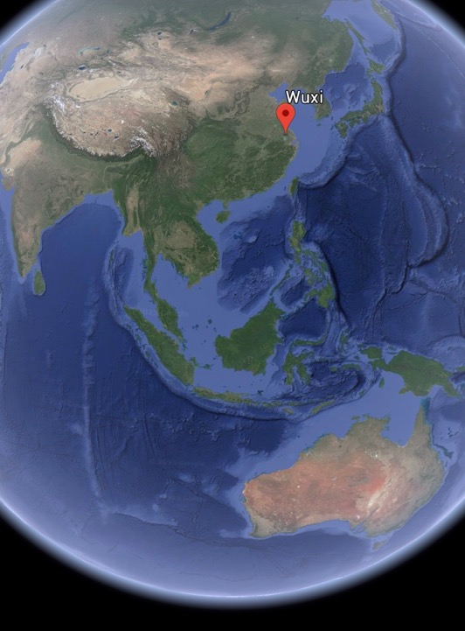
BAIFA
located in Wuxi National High-Tech Industrial Development Zone, known as area of the world manufacture center as it gathers Baifa most main suppliers.
Surrounded by our major partners
PRIME RANGE POWER PARTNER
CUMMINS, VOLVO PENTA, MTU-ROLLS ROYCE
SCANIA
STANDBY RANGE POWER PARTNER
PERKINS, MITSUBISHI, SDEC, YUCHAI, BAUDOUIN WEICHAI
FAW,BAIFA BFY
GAS RANGE
CUMMINS, WEICHAI, MWM, BAIFA
ALTERNATOR RANGE
STAMFORD AVK,
LEORY SOMER, MECCALTE
BAIFA BF Alternator
45 mins to Shanghai by Train
40 mins to Wuxi Int’l Airport
15 mins to High Speed Train Station
3 hours to Shanghai Port
WHERE IS BAIFA
Notes:
Baifa located in Wuxi XISHAN High-Tech Zone - China's manufacturing heartland - we're surrounded by key partners. For our
PRIME RANGE POWER PARTNER
CUMMINS, VOLVO PENTA, MTU-ROLLS ROYCE, SCANIA engines.
STANDBY RANGE POWER PARTNER
PERKINS, MITSUBISHI, SDEC, YUCHAI, BAUDOUIN WEICHAI, FAW,BAIFA BFY.
ALTERNATOR PARNTER
STAMFORD AVK,
LEORY SOMER, MECCALTE
BAIFA Alternator
This ecosystem enables just-in-time production with 45 mins access to Shanghai by train and 3 hours to Shanghai Port.

Slide 9

The success story of our business and products over the past 32 years relies on the spirit of our culture..
“ INTEGRITY & HONESTY”.
We pursue solutions with great enthusiasm. Customer needs are our priority, and we pay close attention to every required detail.
BAIFA CULTURE
Notes:
For 33 years, 'Integrity & Honesty' has been our cultural cornerstone. We prioritize customer needs with meticulous attention to detail, driving enthusiastic solution pursuit.

Slide 10
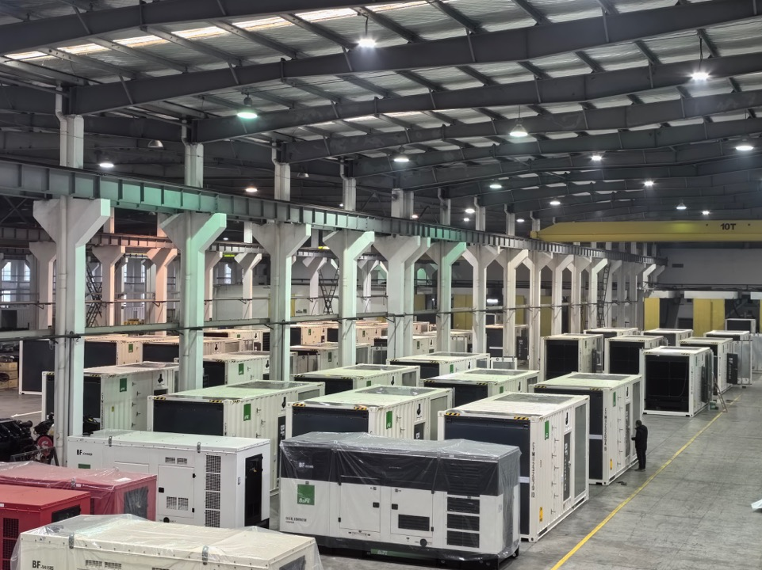
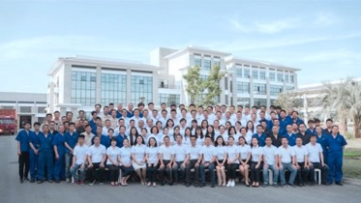
Number of employees: 180+
Registered capital: 24 MILLION USD
Asset value: 80 Million USD.
Production capacity: 5000-6000 units/year
Sales volume average: 80,000,000 USD/year.
Markets: More than 80 countries and regions.
KEY NUMBERS
Notes:
Our strength in numbers:
180+ employees
$24M registered capital
$80M asset value
5,000-6,000 unit annual capacity
$80M average annual sales across 80+ countries

Slide 11
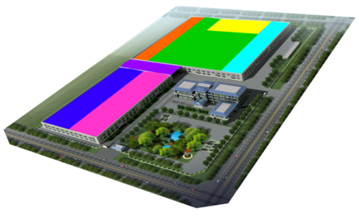
OVERALL FLOOR AREA: 60000 ㎡
WORKSHOP: 35000 ㎡
OFFICE BUIDLING: 5500 ㎡
sheet metal
production areas for gas gen-sets
warehouse
testing room
dispatch area
production areas for diesel gen-sets
semi-finished products area
FACILITY
Notes:
Spanning 60,000㎡ with 35,000㎡ workshops and 5,500㎡ office space, our facilities include sheet metal warehouses for canopy and base frame fabrication, 5 production lines, and 10 diesel & gas genset testing rooms- all designed for vertical integration excellence.

Slide 12

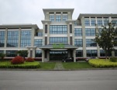
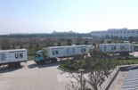
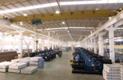


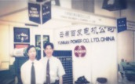
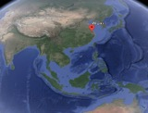
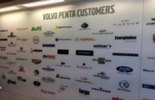



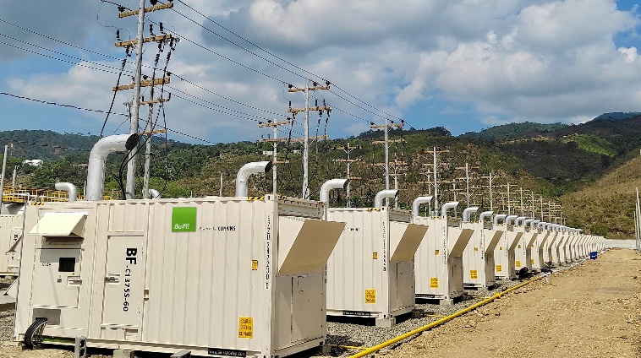
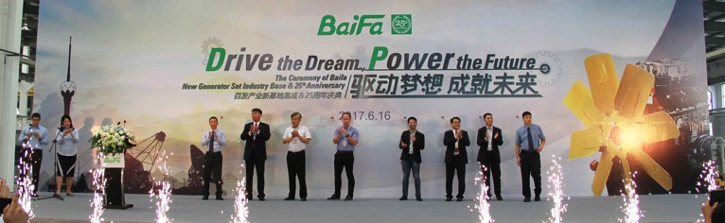
The Largest UN
Procurement
Baifa established global distributor network.
Annual export volume exceeded 30 million dollars/year, accounting for 40% of the company's total sales revenue.
2023 TOP KVA 4000kVA/U
2024-2025 LARGEST DIESEL POWER PLANT IN LATAM
Launched IACS approved marine generators and 4 ranges tower lights.
New milestone: MTU global partner.
Baifa established
in Yunan Province.
1992
2001
2006
2012
2017
33 YEARS
1998
2001
2005
2010
2015
2017
2024-2025
One of the first
Volvo Penta GOEM
OEM OF CUMMINS
OEM OF STAMFORD.
Baifa relocated its manufacturing facility to Wuxi.
Baifa moved to 50000㎡ new plant.
Achieved ISO 9001 ISO14001.
60 million in foreign investment was secured to establish one of the largest genset manufacturing plants.
66000㎡ new factory fully operational;
Achieved OHSAS18001 and ISO45001;
Capable of assembling and testing gas and marine genset.
In its 25th Anniversary year, Baifa became the first OEM to introduce the Baudouin range of generators to global distributors.
Annual export volume exceeded 70 million USD;
Annual revenue exceeded 90 million USD.
Notes:
Our 33-year journey includes:
1992: Yunnan founding
1997: FIRST OEM of VOLVO PENTA IN CHINA and only one in VOLVO SWEDISH HQ Customer wall.
OEM of CUMMINS & Stamford.
2001: MTU global partnership
2004: We achieved largest United nation purchase in the history.
2005: Wuxi relocation to new plant 50000square meter, first to achieved ISO9001 ISO14001 in the industry.
2010: $60M foreign investment for new facility
2015: Move into 60,000㎡ new plant ISO18001 & 45001, marine IACS CCS certification, capability for marine genset, and production of ligting tower.
2017: 25 years anniversary. Baifa became the first OEM to introduce the Baudouin range of generators to global distributors.
2023: 4,000kVA TOP KVA achievement
2024-2025: Latin America's largest diesel power plant
2025 Annual export volume exceeded 70 million USD;
Annual revenue exceeded 90 million USD.

Slide 13
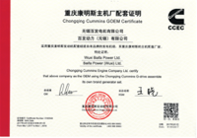




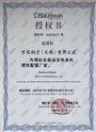





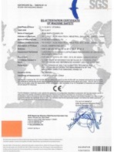
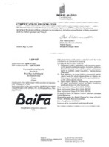



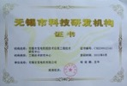
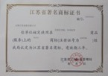
CERTIFIED
OEM
CERTIFICATES
ISO
9001/14001/45001
CE
GLOBAL TRADE MARK
HONORS & REWARDS
IACS
Notes:
BAIFA holds multiple international certifications, including ISO 9001, ISO 14001, and ISO 45001, as well as CE certification and OEM authorizations. With authorized OEM certification, BAIFA generator design and manufacturing under original OEM guidance and authorization, meanwhile our dealers and customer will enjoy global warranty. which reflect our commitment to quality and global standards.

Slide 14
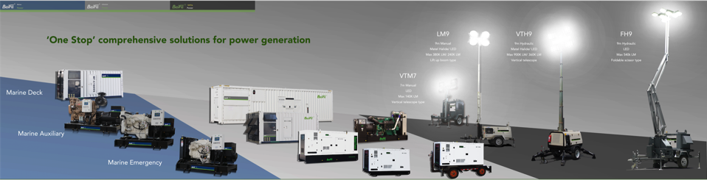
Baifa marine generator range offers:
Marine Auxiliary, Marine Emergency and Marine deck/harbor generator for all kinds of vessel power application.
CCS certified as standard.
Baifa Industrial generator range offers:
Wide range of capacity, engine and type solutions for every kinds of industrial application.
Baifa lighting towers
offers:
Four types series of tower to suit different types of construction, events and mining illumination needs.
UNLEASE THE POWER OF ENGINE
Notes:
Here is four types of generator product we provide: Industrial diesel generator, marine generator and lighting tower.

Slide 15

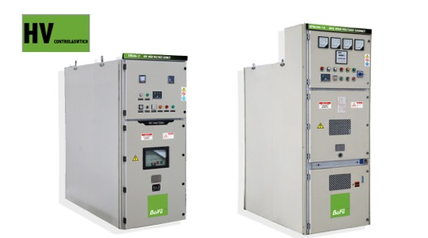
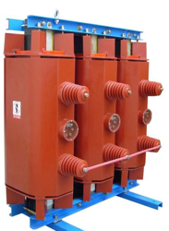
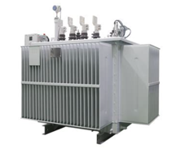
PANELS
LV low voltage switch panels
HV high voltage switch panels up to 35kV
TRANSFORMERS
Oil immersed type transformers up to 110kV
Dry type transformers up to 35kV
American standard box type substation
Euro standard box type substation
HV&LV SWITCH PANELS & TRANSFORMERS
Notes:
Our LV/HV switch panels (up to 35kV) and transformers (up to 110kV) include American/Euro standard box substations and dry/oil-immersed types - complete power infrastructure solutions.

Slide 16
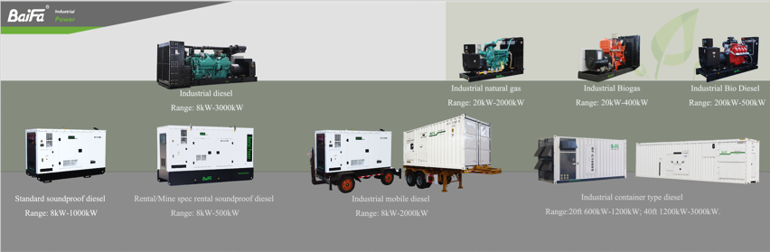
INDUSTRIAL GENERATOR TYPES
* Baifa offers various types of standard power generator products for customer’s choice or meet project demand.
* Above mentioned is standard products only, for special or customized requirement please contact Baifa sales for enquiry.
Notes:
* Baifa offers various types of standard power generator products for customer’s choice or meet project demand.
* Above mentioned is standard products only, for special or customized requirement please contact Baifa sales for enquiry.

Slide 17
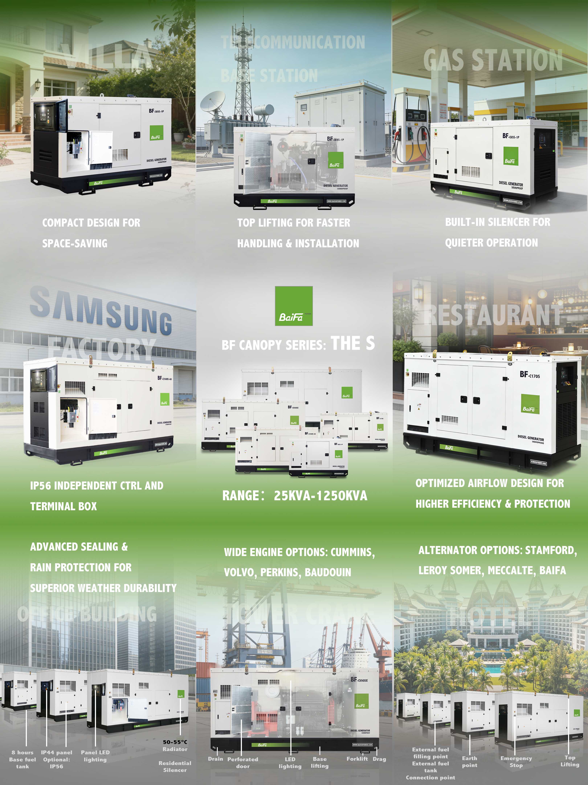
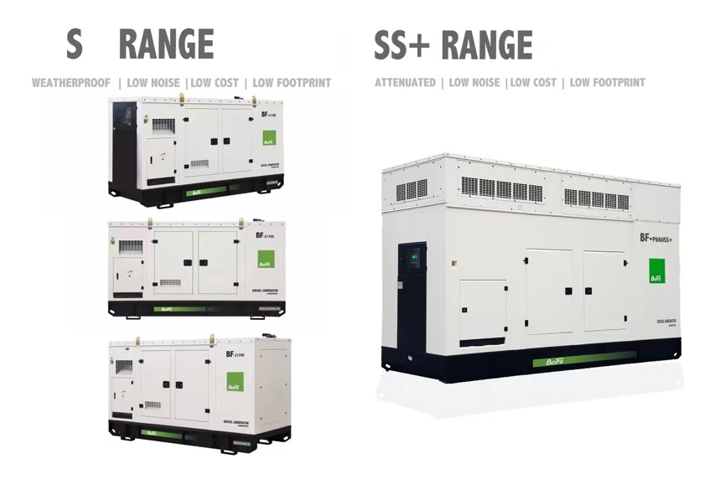

INDUSTRIAL GENERATOR TYPES
Notes:
S CANOPY
FEATURES: STANDARD BAIFA DISTRIBUTOR TYPE
RANGE: 8-1250kVA
Reliable power solutions must adapt to diverse real-world applications — from residential backup and commercial facilities to industrial operations and infrastructure projects.
Baifa S range silent generator sets are engineered for these environments, combining low-noise performance with practical, field-proven design.
✔ Compact structure for space-limited installations
✔ Top lifting design for faster handling and deployment
✔ Optimized airflow for improved cooling and durability
✔ Independent control panel DC &terminal box AC for safety, easier connection and maintenance
✔ LED panel lighting and LED engine room lighting
✔ Perforated sheet on all doors, rigid and easy to clean.

Slide 18
INDUSTRIAL GENERATOR TYPES
Notes:
SS+ CANOPY
FEATURES: UPGRADE BASED ON S, LOWEST NOISE WITH LOW FOOTPRINT
RANGE: 300-700kVA

Slide 19
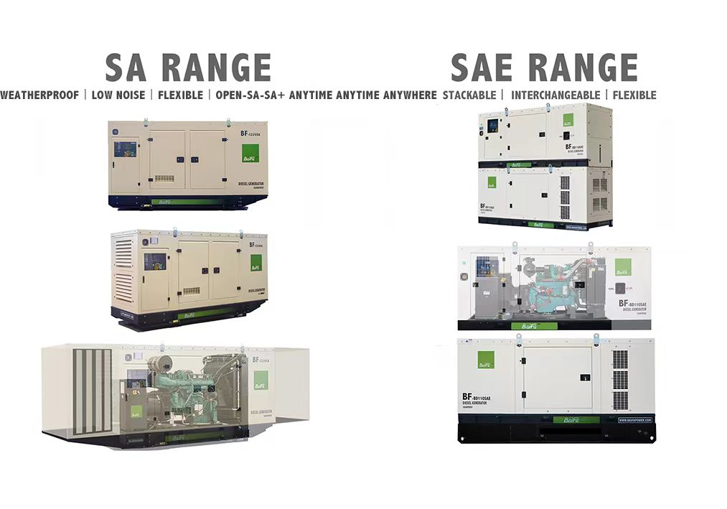
INDUSTRIAL GENERATOR TYPES
Notes:
SA CANOPY
FEATURES: INTERCHANGEABLE BETWEEN OPEN AND SOUNDPROOF,Bigger air intake for hot ambient, FLEXIBLE TO UPGRADE IP LEVEL & NOISE
RANGE:100-1250kVA
SAE CANOPY
FEATURES: STACKABLE in shipping container save half shipping cost, INTERCHANGEABLE BETWEEN OPEN AND SOUNDPROOF, AND FLEXIBLE TO UPGRADE FUEL TANK FOR TELECOM OR RENTAL APPLICATIONS.
RANGE: 25-125kVA

Slide 20
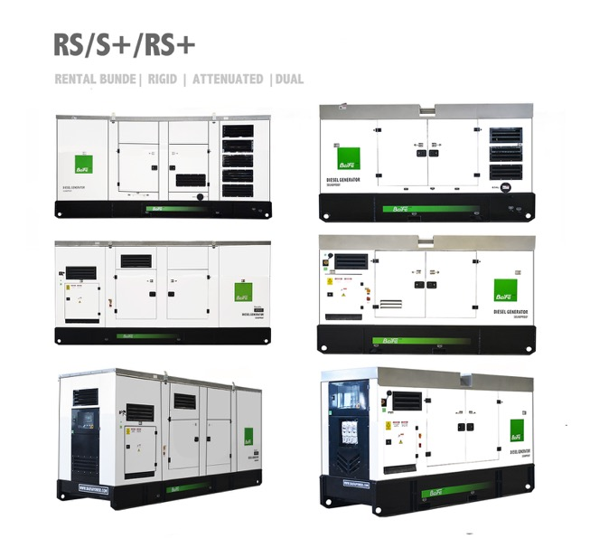
INDUSTRIAL GENERATOR TYPES
Notes:
RS CANOPY
FEATURES: DESIGNED FOR RENTAL with 24hours bunded fuel tank up tp 350kVA, above 350kVA with 12hours fuel tank.
RANGE: 25-700kVA
S+ CANOPY
FEATURES: ATTENUATED AIR INTAKE AND DISCHARGE, 2.5mm CANOPY, DUAL SILENCER
RANGE: 25-700kVA
RS+ CANOPY
FEATURE: DESIGNED FOR RENTAL WITH LOW NOISE REQUIREMENT RS+ including of features of RS and S+
RANGE 25-700kVA
, optional outlet sockets and power lock.

Slide 21
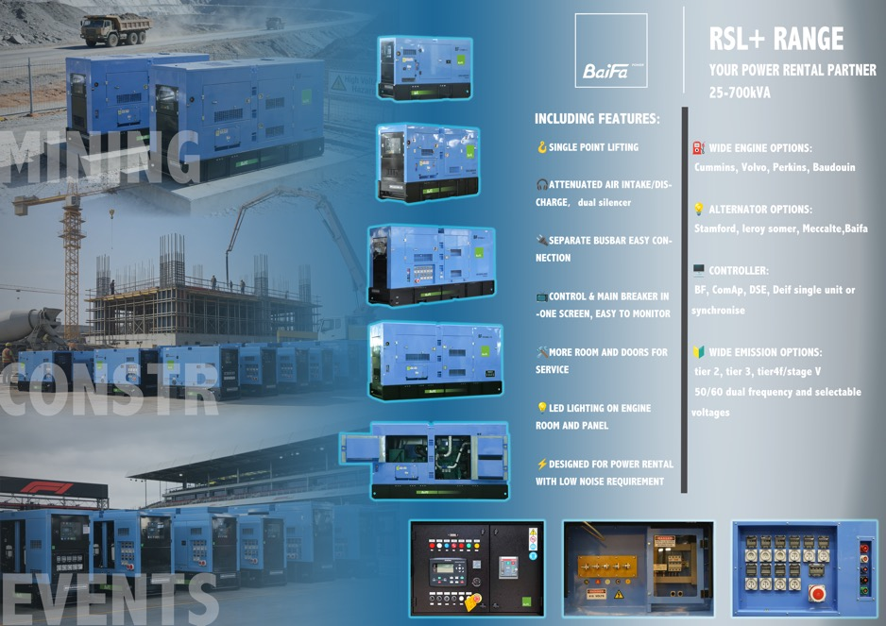
INDUSTRIAL GENERATOR TYPES
RSL+
SINGLE POINT LIFTING |
DESIGNED FOR RENTAL
WITH LOW NOISE
Notes:
RSL+ CANOPY
FEATURE: STACKABLE for storage, SINGLE POINT LIFTING, EXTERNAL CONNECTION BUSBAR for easy and reliable connection, DESIGNED FOR RENTAL WITH LOW NOISE REQUIREMENT, optional outlet sockets and power lock.
RANGE 25-700kVA

Slide 22
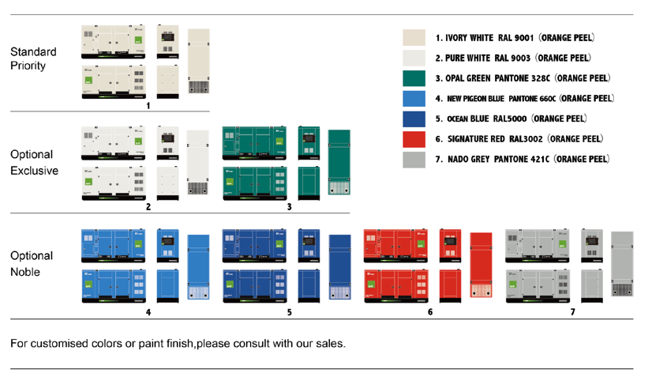
INDUSTRIAL GENERATOR TYPES
Notes:
This presents the color options for our industrial generators.
The Standard Priority section lists seven colors with an Orange Peel finish, including white, green, blue, red, and grey.
For more premium choices, Optional Exclusive and Optional Noble categories are available.
Custom colors or special finishes can be arranged by contacting our sales team.
We also provide optional Galvanized canopy & base frame, stainless canopy & exhaust system, C5M electrophoretic painting.

Slide 23
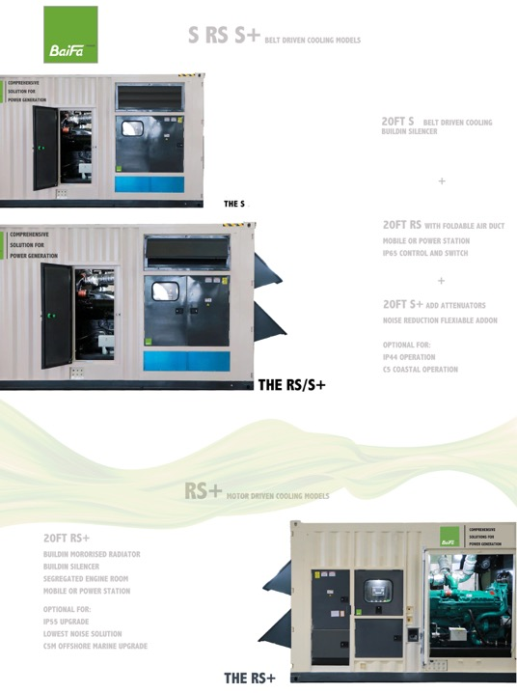
INDUSTRIAL GENERATOR TYPES
Notes:
Our standard 20ft container including:
S type 50degree belt driven radiator, louver air intake, top discharge, IP44 control and terminal box.
RS type including all features of S, but with IP56 control and terminal box, S+ including all features of S, but with external foldable air duct include container room protection level and reduce noise.
S+ type including all features of RS, and add additional intake and discharge attenuators to reduce noise
RS+ including all features of S+ but with segregated engine room and radiator room for lower noise performance, and engine room upgradeable to IP55 and C5M requirement.

Slide 24
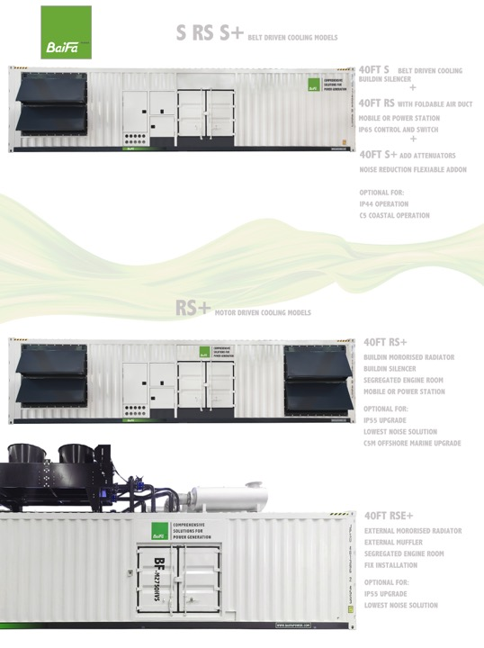
INDUSTRIAL GENERATOR TYPES
Notes:
Our 40-foot generator series offers flexible belt-driven and motor-driven cooling configurations for mobile or fixed installations. RS+ and RSE+ with optional IP55 and C5 for high dust mining or coastal or high humid and corrosive offshore conditions.

Slide 25
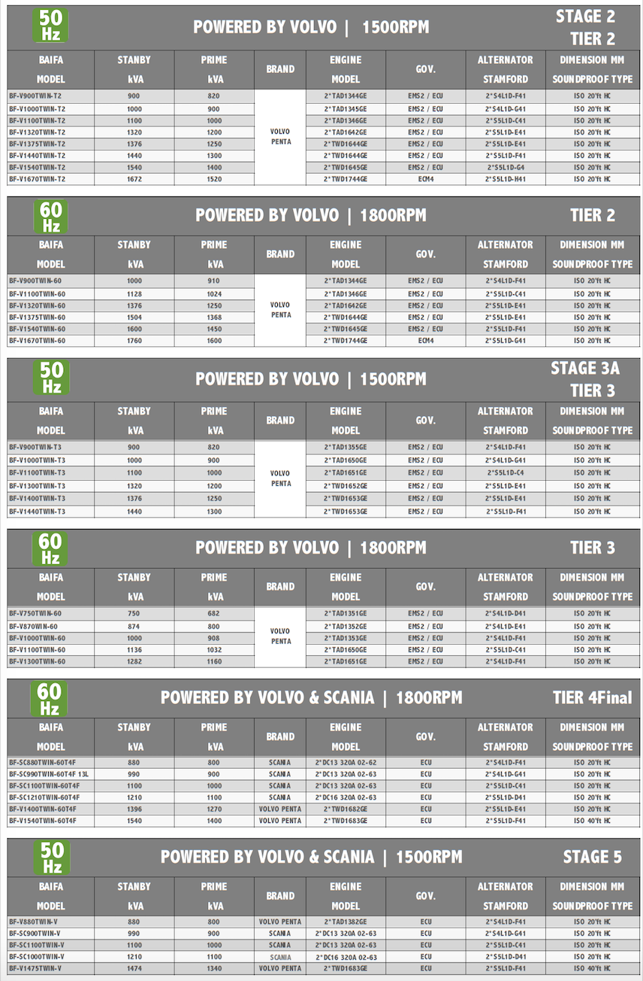
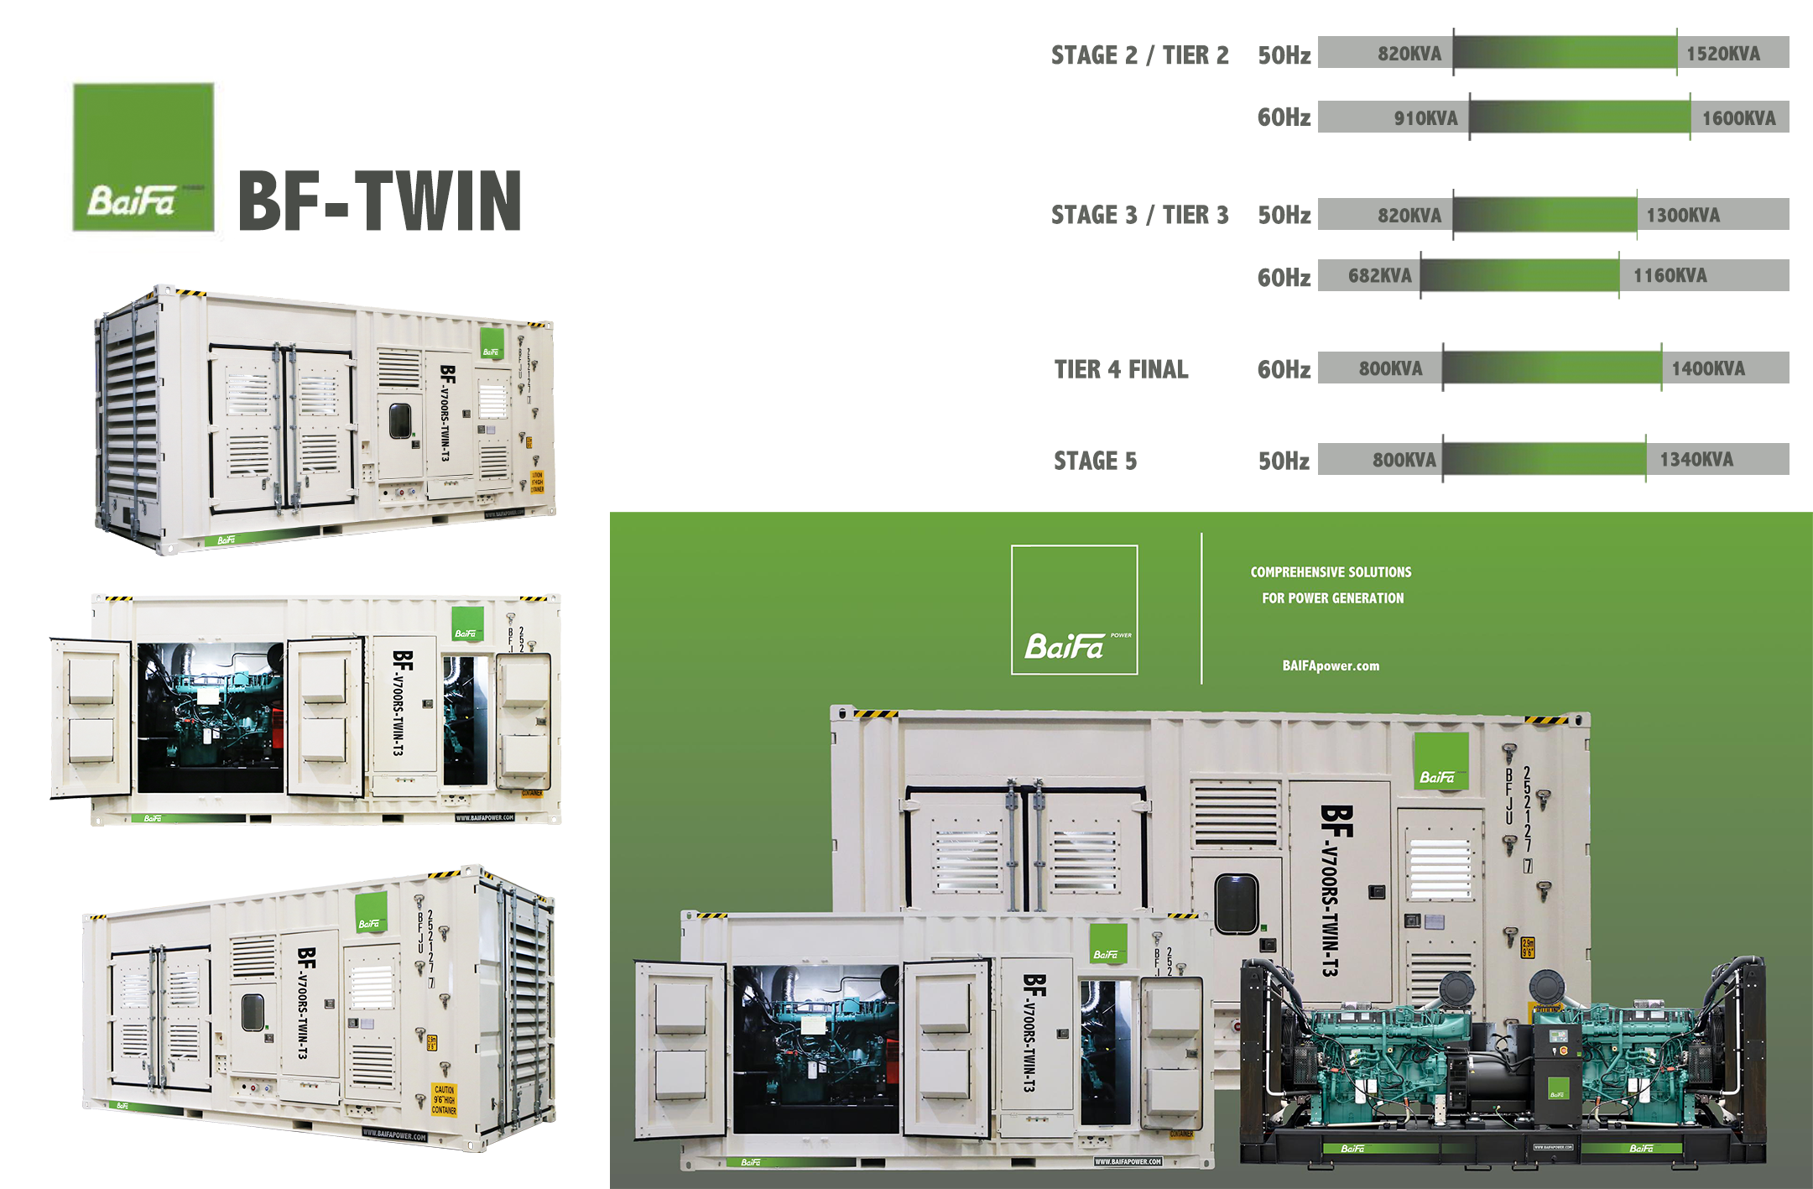
INDUSTRIAL GENERATOR TYPES
Notes:
BF-TWIN based on 20ft and BF-QUAD based on 40ft container to allows maximum 2000kVA prime output with multiple engines, designed for rental, aimed to:
Reduce fuel consumption at variable load.
Meet emission requirement with compact design.
Faster delivery using multiple engines compare to a bigger engines.

Slide 26
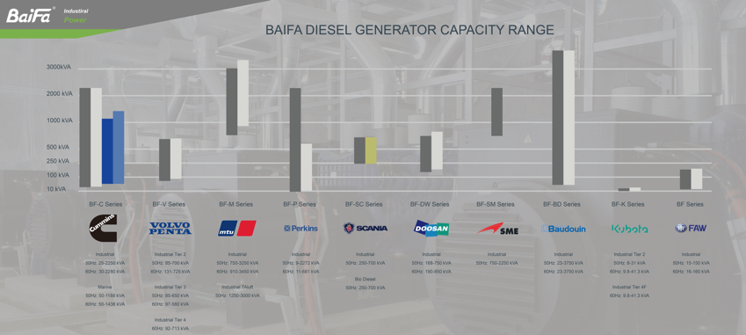
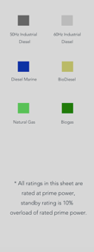
GENRATOR POWER DIESEL RANGE
* Baifa offers wide range of Industrial diesel, natural gas and marine power generator products for customer’s choice or meet project demand.
* Above mentioned is standard power range only, for special requirement please contact Baifa sales for enquiry.
Notes:
Baifa offers a wide range of industrial diesel, natural gas, and marine power generator products to meet customer needs and project demands. The following pages cover our standard power range, and for special requirements, our sales team is ready to assist.
BAIFA COMPETITIVE DIESEL PRIME RANGE: CUMMINS, VOLVO, MTU, PERKINS
BAIFA COMPETTIVE DIESEL STANDBY RANGE: BAUDOUIN, DOOSAN, SME MITSUBISHI,
BIODIESEL: SCANIA
MARINE: CUMMINS

Slide 27
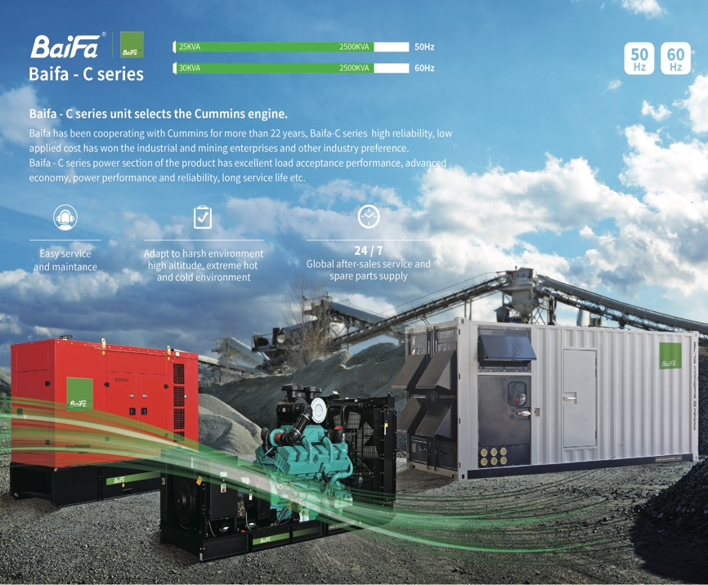

BF-C CUMMMINS POWERED
25-2500kVA WIDE RANGE IDEAL FOR STOCK/RENTAL
LOW OPERATIONAL COST
PARTS ACCESSIBITILIES
GLOBAL WARRANTY AND SERVICE
EMISSION RANGE:
NON-EMISSION
Q RANGE CHINA STAGE3/STAGE3A/TIER 3 FOR 560kW BELOW
Q RANGE CHINA STAGE3/TIER 2 FOR 560kW ABOVE
GENERATOR POWER
DIESEL RANGE
Notes:
BF-C CUMMMINS POWERED
25-2500kVA WIDE RANGE IDEAL FOR STOCK/RENTAL and all kinds of prime and standby applications
LOW OPERATIONAL COST
PARTS ACCESSIBITILIES
GLOBAL WARRANTY AND SERVICE
EMISSION RANGE:
NON-EMISSION
Q RANGE CHINA STAGE3/STAGE3A/TIER 3 FOR 560kW BELOW
Q RANGE CHINA STAGE3/TIER 2 FOR 560kW ABOVE

Slide 28
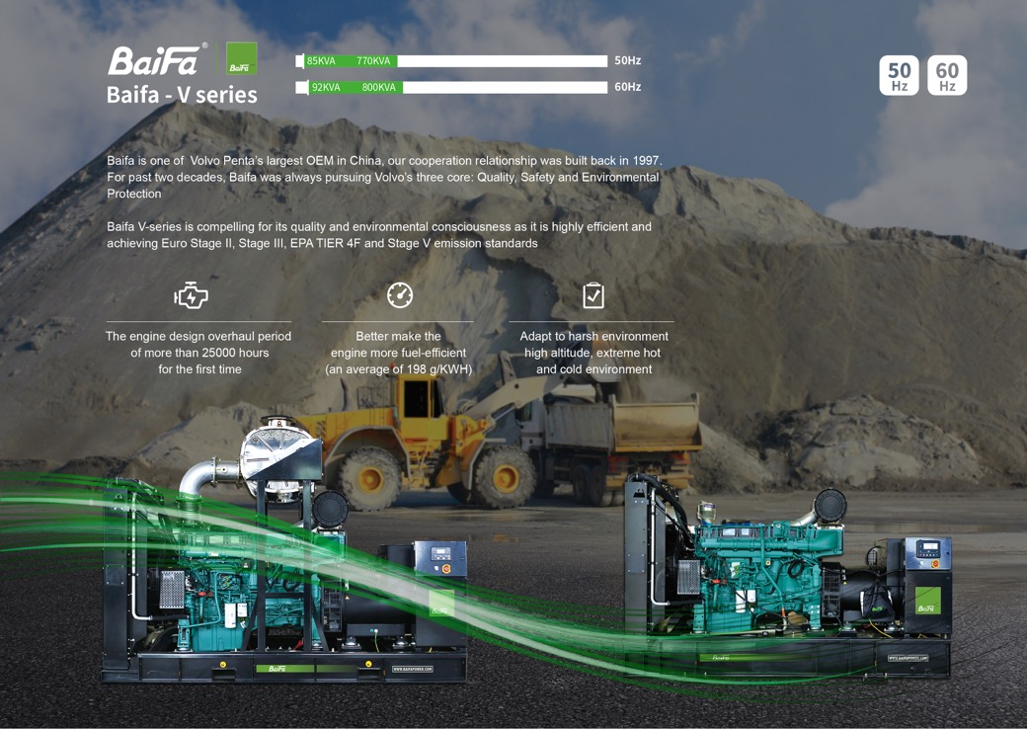
BF-V VOLVO PENTA POWERED
200-750kVA MEDIUM RANGE
TWIN 1000kVA/1300kVA/1400kVA
LOWEST FUEL CONSUMPTION
TWICE LONGER SERVICE & OVERHAUL INTERVAL
55 DEGREE RADIATOR AS STANDARD
FULL RANGE G3 CLASS
LOW NOISE & FOOTPRINT
PARTS ACCESSIBITILIES
GLOBAL WARRANTY AND SERVICE
SWEDEN ORIGIN
TAILORED FOR:
HIGH END CONTINUOUSPRIME/STANDBY MEDIUM SIZE FACILITY
HIGH EMISSION REQUIREMENT RENTAL
HIGH ALTITUDE/AMBIENT APPLICATION
EMISSION RANGE:
STAGE 2/ TIER2
STAGE 3A/ TIER3
TIER4I/F
STAGE V
GENERATOR POWER DIESEL RANGE
Notes:
BF-V VOLVO PENTA POWERED
200-750kVA MEDIUM RANGE
TWIN 1000kVA/1300kVA/1400kVA
LOWEST FUEL CONSUMPTION
TWICE LONGER SERVICE & OVERHAUL INTERVAL
55 DEGREE RADIATOR AS STANDARD
FULL RANGE G3 CLASS
LOW NOISE & FOOTPRINT
PARTS ACCESSIBITILIES
GLOBAL WARRANTY AND SERVICE
8L engine INDIA origin, 13L 16L SWEDEN ORIGIN
TAILORED FOR:
HIGH END CONTINUOUSPRIME/STANDBY MEDIUM SIZE FACILITY
HIGH EMISSION REQUIREMENT RENTAL
HIGH ALTITUDE/AMBIENT APPLICATION
EMISSION RANGE:
STAGE 2/ TIER2
STAGE 3A/ TIER3
TIER4I/F
STAGE V

Slide 29
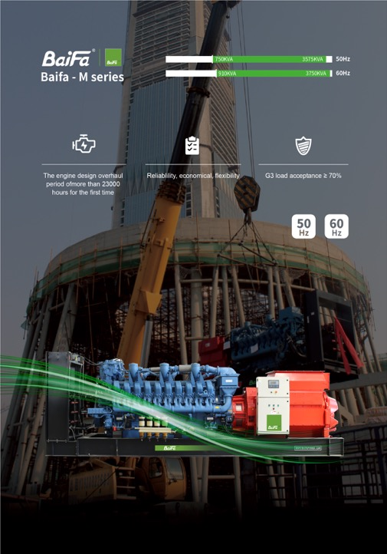
BF-M MTU ROLLS-ROYCE POWERED
750kVA-3575kVA HIGH RANGE
LOWEST FUEL CONSUMPTION IN ITS RANGE
LOW OPERATIONAL COST
TWICE LONGER SERVICE & OVERHAUL INTERVAL
PARTS ACCESSIBITILIES
FULL RANGE G3 CLASS
GLOBAL WARRANTY AND SERVICE
OFFERS GERMANY&CHINA ORIGIN
TAILORED FOR PROJECT APPLICATIONS
POWER STATION 3A
STANDBY 3D
PRIME 3B/3E
DATA CENTER CONTINUOUS 3F
GRID STABLIZATION POWER 3G
HIGH ALTITUDE APPLICATION
EMISSION RANGE:
NON-EMISSION FUEL PRIORITIES
EMISSION PRIORITY
TALUFT/SINGAPORE EMISSION/CHINA STAGE3/TIER 2
GENERATOR POWER DIESEL RANGE
Notes:
BF-M MTU ROLLS-ROYCE POWERED
750kVA-3575kVA HIGH RANGE
LOWEST FUEL CONSUMPTION IN ITS RANGE
LOW OPERATIONAL COST
TWICE LONGER SERVICE & OVERHAUL INTERVAL
PARTS ACCESSIBITILIES
FULL RANGE G3 CLASS
GLOBAL WARRANTY AND SERVICE
OFFERS GERMANY&CHINA ORIGIN
TAILORED FOR PROJECT APPLICATIONS
POWER STATION 3A
STANDBY 3D
PRIME 3B/3E
DATA CENTER CONTINUOUS 3F
GRID STABLIZATION POWER 3G
HIGH ALTITUDE APPLICATION
EMISSION RANGE:
NON-EMISSION FUEL PRIORITIES
EMISSION PRIORITY
TALUFT/SINGAPORE EMISSION/CHINA STAGE3/TIER 2

Slide 30
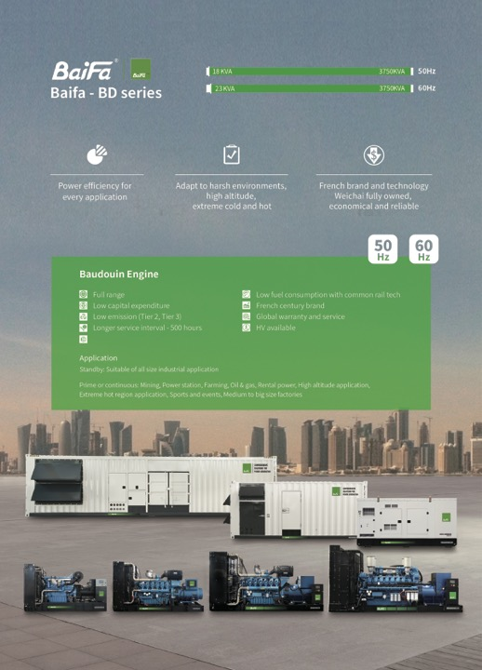
BF-BD BAUDOUIN POWERED
17KVA-4000kVA FULL RANGE SOLUTION
LOWEST CAPEX FOR STANDBY MARKET
PARTS ACCESSIBITILIES
FULL RANGE G3 CLASS
GLOBAL WARRANTY AND SERVICE
TAILORED FOR PROJECT APPLICATIONS
STANDBY
DATA CENTER CONTINUOUS
HIGH ALTITUDE
EMISSION RANGE:
NON-EMISSION FUEL PRIORITIES
EMISSION PRIORITY
TALUFT/SINGAPORE EMISSION/CHINA STAGE3/TIER 2
GENERATOR POWER DIESEL RANGE
Notes:
BF-BD BAUDOUIN POWERED
17KVA-4000kVA FULL RANGE SOLUTION
LOWEST CAPEX FOR STANDBY MARKET
PARTS ACCESSIBITILIES
FULL RANGE G3 CLASS
GLOBAL WARRANTY AND SERVICE
TAILORED FOR PROJECT APPLICATIONS
STANDBY
DATA CENTER CONTINUOUS
HIGH ALTITUDE
EMISSION RANGE:
NON-EMISSION FUEL PRIORITIES
EMISSION PRIORITY
TALUFT/SINGAPORE EMISSION/CHINA STAGE3/TIER 2

Slide 31
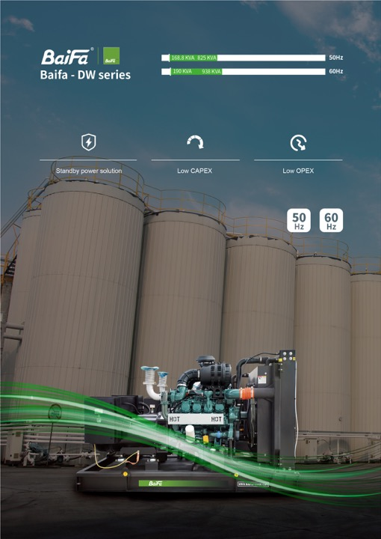
BF-DW HYUNDAI POWERED
168kVA-1000kVA MEDIUM RANGE
LOW CAPEX
PARTS ACCESSIBITILIES
GLOBAL WARRANTY AND SERVICE
OFFERS KOREA ORIGIN
TAILOR FOR PROJECT APPLICATIONS
STANDBY MEDIUM SIZE FACILITY
EMISSION RANGE:
NON-EMISSION
TIER 2 & 3
TIER 4F
STAGE V
GENERATOR POWER DIESEL RANGE
Notes:
BF-DW HYUNDAI POWERED
168kVA-1000kVA MEDIUM RANGE
LOW CAPEX
PARTS ACCESSIBITILIES
GLOBAL WARRANTY AND SERVICE
OFFERS KOREA ORIGIN
TAILOR FOR PROJECT APPLICATIONS
STANDBY MEDIUM SIZE FACILITY
EMISSION RANGE:
NON-EMISSION
TIER 2 & 3
TIER 4F
STAGE V

Slide 32
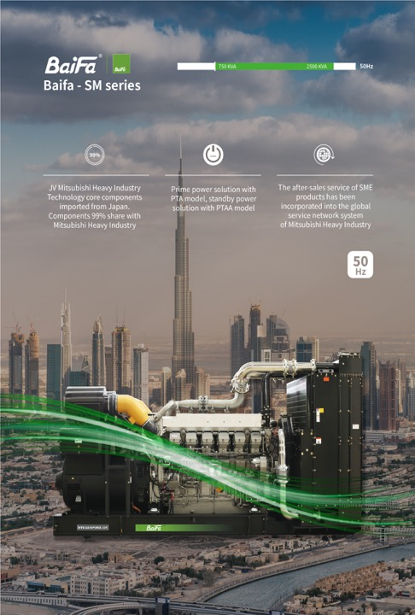
BF-SM/MH MITSUBISHI POWERED
750kVA-2500kVA HIGH RANGE
LOW CAPEX
PARTS ACCESSIBITILIES
PTA RANGE G3 CLASS
GLOBAL WARRANTY AND SERVICE
OFFERS CHINA&JAPAN ORIGIN
TAILOR FOR PROJECT APPLICATIONS
STANDBY
PTA RANGE PRIME&CONTINUOUS POWER STATION
EMISSION RANGE:
NON-EMISSION FUEL PRIORITIES
GENERATOR POWER DIESEL RANGE
Notes:
BF-SM/MH MITSUBISHI POWERED
750kVA-2500kVA HIGH RANGE
LOW CAPEX
PARTS ACCESSIBITILIES
PTA RANGE G3 CLASS
GLOBAL WARRANTY AND SERVICE
OFFERS CHINA&JAPAN ORIGIN
TAILOR FOR PROJECT APPLICATIONS
STANDBY
PTA RANGE PRIME&CONTINUOUS POWER STATION
EMISSION RANGE:
NON-EMISSION FUEL PRIORITIES

Slide 33
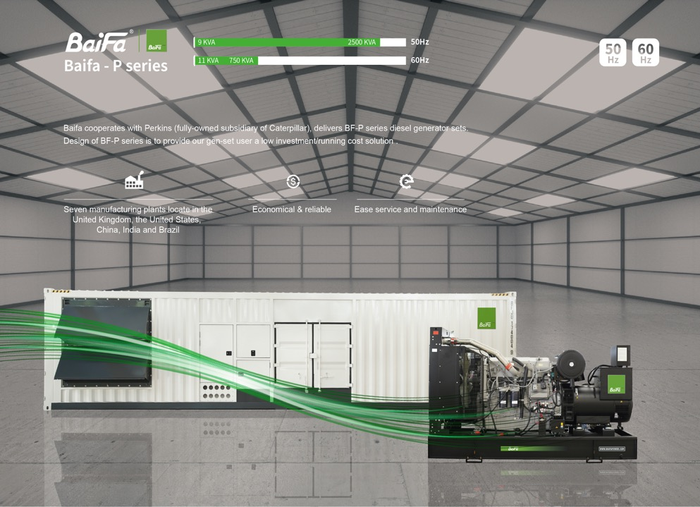
BF-P PERKINS POWERED
10kVA-2500kVA FULL RANGE
PARTS ACCESSIBITILIES
GLOBAL WARRANTY AND SERVICE
OFFERS UK/USA/INDIA/CHINA ORIGIN
TAILOR FOR PROJECT APPLICATIONS
STANDBY/PRIME
EMISSION RANGE:
NON-EMISSION FUEL PRIORITIES
STAGE3A/TIER 3 FOR 560kW BELOW
GENERATOR POWER DIESEL RANGE
Notes:
BF-P PERKINS POWERED
10kVA-2500kVA FULL RANGE
PARTS ACCESSIBITILIES
GLOBAL WARRANTY AND SERVICE
OFFERS UK/USA/INDIA/CHINA ORIGIN
TAILOR FOR PROJECT APPLICATIONS
STANDBY/PRIME
EMISSION RANGE:
NON-EMISSION FUEL PRIORITIES
STAGE3A/TIER 3 FOR 560kW BELOW

Slide 34
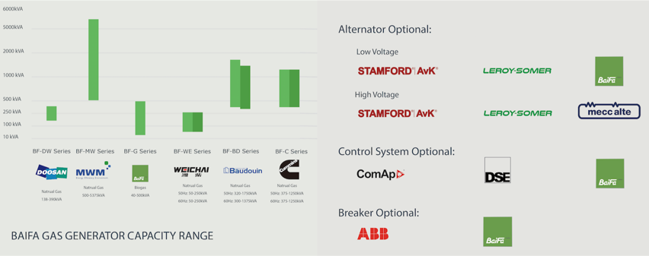

GAS RANGE
* Baifa offers a wide range of industrial diesel, natural gas, and marine power generator products to meet customer needs and project demands.
* The above covers only our standard power range. For special requirements, please contact Baifa Sales for more information.
Notes:
Our gas generator range offers flexible low and high voltage configurations. CUMMINS range from 300kW-1200kW is the most fast delivery and economic solutions, with twin power solution, delivers up to 2.4MW per unit output, adapts to natural gas, biogas and LPG gas.

Slide 35


MARINE RANGE
* Baifa offers a wide range of Cummins-powered marine generator products to meet customer preferences and the demands of various vessels.
* The above covers only our standard power range. For special requirements, please contact Baifa Sales for more information.
Notes:
In the marine sector, Baifa offers a wide range of Cummins-powered marine generator products to meet customer preferences and the demands of various vessels.
BAIFA MARINE GENERATORS INCLUDES: AUXILIARY TYPE COOLED SEAWATER BY HEAT EXCHANGER; EMERGENCY TYPE COOL BY AIR VIA BELT DRIVEN RADIATOR WITH DUAL STARTING SYSTEM; MARINE DECK TYPE FOR PORT OR EMERGENCY APPLICATION.

Slide 36

DIESEL
LIGHTING RANGE
* Baifa offers a wide range of Kubota / Yanmar engine-powered lighting towers to meet customer preferences and the demands of various job or mine sites.
Notes:
For job site illumination, our diesel lighting towers, powered by Kubota or Yanmar engines, are designed to meet the demands of construction, mining, and event applications.
FH9 FOR HIGH DUTY MINING SITE, WITH MAX OF LIGHTS. HYDRAULIC MAST BOOM, HYDRAULIC LEGS AND HYDRAULIC MAST ROTATION. AVAILBLE IN DC SYSTEM.
LM9: TRADITIONAL BOOM FOR 9M. CAN FIT 22 UNITS IN ONE 40FT.
VTH9; MOST POPULAR HYDRAULIC MAST LIGHTING TOWER WITH ELECTRIC LIGHT TILT. AVAILBLE IN DC SYSTEM.

Slide 37

DIESEL
LIGHTING RANGE
* Baifa offers a wide range of Kubota / Yanmar engine-powered lighting towers to meet customer preferences and the demands of various job sites.
Notes:
VTM7 MOST POPULAR MODEL FOR ROAD CONSTRUCTION AND CONSTRUCTION SITE. IT IS LOW FOOTPRINT, EASY TO MOVE AND LOW CAPEX&OPEX.

Slide 38

SOLAR
LIGHTING RANGE
* Baifa offers solar-powered lighting towers to meet customer preferences and the demands of various job or mine sites.
SOLAR/BATTERY SERIES | MODELS | HEIGHT | SOLAR | BATTERY | LIGHTS | TOTAL LM
VTM7 HYBRID | VTM7-E400 HYBRID | 7m | 3*435W | 4*100AH | 4*100W LED | 64000
 | VTM7-E800 HYBRID | 7m | 4*460W | 4*200AH | 4*200W LED | 136000
Notes:
And for environmentally conscious operations, we offer solar-powered lighting towers. Our hybrid models combine solar panels and batteries to deliver clean, silent, and efficient lighting.

Slide 39



SINGLE UNIT
SYCHRONISE
CONTROLLER
Notes:
BF SERIES CONTROLLER; BF61 FUNCTION=DSE6120; BF62 FUNCTION=DSE7320. MOST VALUE FOR MONEY ON OPERATION AND MAINTENANCE. AVAILBLE IN DISTRIBUTOR. You can also find our COMAP and DEEPSEA options for single unit, AMF function and synchronize operation.

Slide 40





TURNKEY ACCESSORIES TRANSFORMER/CABLE/ATS/HV PANEL/ HV GENERATOR/ LOADBANK
Notes:
To support complete project delivery, our turnkey accessories include transformers, cables, ATS, high-voltage panels, and load banks, ensuring we can handle every aspect of your power needs.

Slide 41

PROJECT CASE STUDIES
Notes:
Now, let’s bring our capabilities to life through some of our major projects. From high-rise buildings to industrial facilities, Baifa has delivered reliable power solutions across the globe.

Slide 42




HIGH-VOLTAGE STANDBY POWER: BUILDING
2015, THE 117 TALLEST HIGH RISE,
NORTHERN, CHINA
In 2015, Baifa supplied standby diesel generators to Tianjin 117 Building, which is the tallest building in North China.
The total height of the building is 597m, with 4 floors underground and 117 floors on the ground. This project totally applied:
Gen-set model:
4*BF-M3250HV
2*BF-M2750HV
1*BF-M2750
Notes:
In 2015, Baifa supplied standby diesel generators to Tianjin 117 Building, which is the tallest building in North China.

Slide 43

HIGH-VOLTAGE STANDBY POWER: BUILDING
2017, LOTUS TOWER, SRI LANKA
Gen-set model: BF-M2750HV
Standby power: 2750kVA
Quantity: 2 units
Two Baifa BF-M2750HV units providing backup power for the most iconic building in Colombo, Sri Lanka.
Notes:
2017 Sri Lanka Lotus tower, the highest TALLEST TOWER in central Asia.

Slide 44

HIGH-VOLTAGE BACK-UP POWER. SAMSUNG: FACTORY
2013, SAMSUNG FACTORY, CHINA
Gen-set model: BF-M2500HV Standby power: 2500kVA, 10.5kV
Quantity: 4 units
In 2013, Baifa provided auto transferred, auto paralleled high-voltage 10.5kV diesel gen-sets and auto-control system powered by four 2000kW MTU engine, total capacity reached 8MW.
MTU engine has the world most advanced fueling system and injection system. This technology allows MTU engines to have advantages in high reliability, fuel economy and low emission compared to other engines.
Notes:
BIGGEST SAMSUNG CITY IN CHINA, TOTAL 4+4 UNITS SUPPLIED.
We also supplied high‑voltage backup power for Samsung Factory and Toyo Factory in Korea, ensuring uninterrupted power for large manufacturing bases.

Slide 45

HIGH-VOLTAGE BACK-UP POWER. TOYO: OFFICE BUILDING/FACTORY
2013, TOYO FACTORY, KOREA
Gen-set model: BF-M2000,HV-60 Standby power: 2200kVA, 6.9kV
Quantity: 4 units
In 2013, we provided 4 sets of 2200kVA diesel generators as back-up power for Toyo Factory in Korea.
60Hz, 6.6kV high-voltage, fully auto controlled and paralleled.
Notes:
SEMI-CONDUCT factory in Korea.

Slide 46



ENTERPRISE EMERGENCY POWER: CHEMICAL ENTERPRISE
A CHEMICAL GROUP, SHANDONG PROVINCE, CHINA
Gen-set model: BF-M2250HV, BF-2500S
Standby power: 2500kVA, 10.5kV
Quantity: 4 units + 1 unit
Notes:
For a chemical enterprise in Shandong, we provided four BF-M2250HV units and one BF-2500S at 2500kVA each, delivering critical backup power for high-stakes industrial operations.

Slide 47


HIGH-VOLTAGE PRIME POWER: FACTORY
2015-2016, INDUSTRIAL ZONE, BENIN
Gen-set model: BF-M2500HV
Prime power: 2250kVA, 22kV
Quantity: 5 units
Baifa provided a Benin customer 5 sets Germany MTU 2250kVA container soundproof diesel gensets, with the whole system boosting to 22kV, used as main power supply on customer’s site.
Notes:
BAIFA OVERSEAS TURNKEY PROJECT. PROVIDES ALL ACCESSORIES FOR THE PROJECT.

Slide 48

ENTERPRISE EMERGENCY POWER: GLASS FACTORY
2023, GLASS FACTORY, ANHUI PROVINCE, CHINA
Gen-set model: BF-SM2250-HV Standby power: 2250kVA, 10.5kV
Quantity: 6 units
Notes:
In 2023, we delivered six BF-SM2250-HV units to a glass factory in Anhui Province, providing reliable standby power to ensure uninterrupted production.

Slide 49

ENTERPRISE EMERGENCY POWER: SEMICONDUCTOR FACTORY
CHONGQING WANGUO SEMICONDUCTOR, CHINA
Gen-set model: BF-SM2250HV Standby power: 1875kVA, 10.5kV
Quantity: 2 units + 1 unit
Chongqing Wanguo Semiconductor Technology Co., Ltd. is a globally leading power semiconductor enterprise. As the first semiconductor manufacturer in Chongqing to integrate chip manufacturing, packaging, and testing, its 12-inch power semiconductor chip manufacturing and packaging & testing base project is primarily engaged in the product design and manufacturing of power semiconductor devices.
The accompanying image shows the two sets of 1875kVA, 10.5kV diesel generator sets configured for this project as backup power.
Notes:
Semiconductor factory in China.

Slide 50



ENTERPRISE EMERGENCY POWER: EDUCATIONAL INSTITUTION
A UNIVERSITY, GUANGZHOU, CHINA
Gen-set model: BF-M1100
Rated power: 1000kVA
Quantity: 7 units
Gen-set model: BF-V700-III
Rated power: 625kVA
Quantity: 3 units
Notes:
We also support public infrastructure. For university of Guangzhou, we supplied backup power with seven BF-M1100 and three BF-V700 units.

Slide 51

NATIONAL EMERGENCY AUTHORITY: DRAINAGE TRAILER
A FIRE AND RESCUE BRIGADE, CHINA
Gen-set model: BF-C70QWT
Power: 63kVA
Quantity: 54 units
Equipped with two 500m³/h drainage units.
Notes:
And for emergency response, a fire and rescue brigade in China received 54* BF-C70ST, each equipped with high-capacity drainage pumps for rapid flood response.

Slide 52

STANDBY POWER: BUILDING
2018, MARINE GATE1, DUBAI, UAE
Gen-set model: BF-SM2100
Standby power: 1900kVA
Quantity: 1 unit
Baifa BF-SM1650 providing backup power for the most iconic building DUBAI MARINE.
Notes:
BAIFA IS THE FIRST TO INTRODUCT MITSUBISHI CHINA TO UAE PROJECT.

Slide 53



STANDBY POWER: HOTEL
2012-2015, MANGROVE HOTE, CHINA
A total of 20MW of emergency power was supplied to different sites of the transnational hotel franchise Mangrove Tree in Sanya, China.
Notes:
LOTS OF 5 STARS HOTEL REFERENCE IN CHINA.

Slide 54


STANDBY POWER: HOTEL
Reference list:
Beijing Crown hotel (Below)
Sanya Hainan Red Forest Hotel
South Sanya Red Forest Hotel
Coral Hotel of Wuzhizhou Island Sanya
Jiujiang Mount Lu zuishi Spa Resort
Shishi Fujian Lvdao International Hotel Co. Ltd.
Qingdao Shandong Ocean Hotel
Banyan Tree Lijiang Yunnan Hotel
Suzhou Taihu Golf Hotel
V-Continent Beijing Parkview Wuzhou Hotel
Jianyang Sichuan Xin Yatu Hotel
Beijing canal people's founding Holiday Inn Ibis Hotel
Baifa gensets have been popular for their robustness and low noise levels, which has allowed our units to supply power for famous overseas hotels.
(Below: Qatar – French Vinci group)
Notes:
LOTS OF 5 STARS HOTEL REFERENCE IN CHINA AND WORLD WIDE.

Slide 55






STANDBY POWER: RAILWAY SYSTEM
Railway system reference list:
Ministry of Railway-Beijing (Right side)
Project of Tianjin West Railway Station of Beijing-Shanghai high-speed railway
Project of Hangzhou Bay Bridge
Kunming Yunnan Railway General Corporation
Tangshan Hebei Railway Station of Beijing-Shanghai high-speed railway
Binhai Tianjin New Area Station of Beijing-Shanghai high-speed railway
Project of newly-built dispatching station of Chengdu Railway Bureau
China Railway Large Maintenance Machinery Group Co. Ltd.
Project of China Railway thirteen Bureau
High speed train control center-Tianjin (Right side)
Notes:
In the railway sector, we have supplied backup power for high-speed rail projects across China and Ministry of Railway in Beijing.

Slide 56

STANDBY POWER: AIRPORT
AIRPORT PROJECT CASES:
Tongren Airport of Guizhou
Daqing Airport of Heilongjiang
Guiyang Leizhuang Airport
Yulin Airport of Shanxi
Wuhu Airport of Anhui
Wuxi Shuofang Airport
Beijing Shahe Airport
Hangzhou Jianqiao Airport
ANGOLA Luena Airport
Erdos Airport of Inner Mongolia
In 2012, Baifa supplied Dalian Branch of China Southern Airlines 1 set standby 1320kW container diesel genset used as standby power supply.
Notes:
Various of airport project including Wuxi airport.

Slide 57




STANDBY POWER: BANKING
Banking system project reference list:
Tianjin Bohai Bank
Wuping Fuzhou Branch of ABC
Dongyang Zhejiang Branch of CCB
Chongqing Branch of Shanghai Pudong Development Bank
Wujiang Jiangsu Rural Commercial Bank
Nantong Branch of ICBC
Tianjin Branch of People's Bank of China
Wuxi Branch of Industrial and Commercial Bank of China Ltd
Tianjin Branch of Bank of communications
Notes:
Our reliability is also trusted in the financial sector, where we have provided standby power for banks across China.

Slide 58




STANDBY POWER: MEDICAL SYSTEM
AAA MEDICAL SYSTEM CASES:
Peking Union Medical College Hospital
Peking University People’s Hospital
Peking University Shou Gang Hospital
Beijing Fu Xing Hospital
Beijing You An Hospital
Beijing An Zhen Hospital
Beijing Ping Gu Hospital
Beijing Chao Yang Hospital
Beijing Huai Rou Hospital
Beijing Hospital of TCM
Beijing Obstetrics and Gynecology Hospital
Peking University Third Hospital
Beijing Emergency Medical Center(120)
Beijing Aerospace Center Hospital
Beijing Shijitan Hospital
Beijing Haidian Hospital
Beijing Mentougou Hospital
Beijing Xuanwu Hospital
After being selected by multiple third-grade class-A hospitals in Beijing, Baifa went on to provide reliable standby power supply to similar hospitals in Tianjin:
Tianjin Chest Hospital
Tianjin Nankai Hospital
Tianjin Hospital
Tianjin Hematology Hospital
Tianjin Armed Police General Hospital
Tianjin Brain Hospital
Notes:
In healthcare, Baifa has been selected by numerous tripal A top-tier hospitals in Beijing and Tianjin.

Slide 59


STANDBY POWER: DATA CENTER
2015, SHANGHAI DATA CENTER, CHINA
Baifa SM-series
Standby power: 2500kVA
Quantity: 8 units
In 2015, Baifa supplied 8 units standby 2000kW diesel gensets to Shanghai BaoCloud project.
Notes:
Shanghai data center with BF-SM high voltage generators.

Slide 60

STANDBY POWER: DATA CENTER
2025, DATA CENTER VIETNAM
Baifa M-series
DCP power: 2250kVA
Quantity: 14 units
DCP power: 2000kVA
Quantity: 10 units
Notes:
As recently as 2025, we delivered 24 units of high-power generators to a data center in Vietnam, further expanding our presence in Southeast Asia.

Slide 61


CONTINUOUS POWER: DATA CENTER
2012, DATA CENTER, CHINA
Variety of Baifa M-series
Power range: 1250kVA to 2000kVA
Quantity: 12 units
Since 2008, Baifa started stretching business into providing diesel generators for telecom industry.
We supplied telecom facilities with varies of reliable, efficient and environment friendly Baifa products, including: BF-Volvo series; BF-MTU series and etc.
Notes:
Data center in Beijing.

Slide 62

CONTINUOUS POWER: STADIUM & ARENA
2009, AFRICA CUP,
LUBANGO STADIUM, ANGOLA
Gen-set model: BF-M1100
Prime power: 1000kVA
Quantity: 4 units
Notes:
In 2009, we powered the Africa Cup with four BF-M1100 units at the Lubango Stadium in Angola, ensuring uninterrupted broadcast and event operations.

Slide 63



CONTINUOUS POWER: CONSTRUCTION CAMP
2015, CONSTRUCTION CAMP, QATAR
Model: BF-C1100QS with QST30-G4 USA engine
Power range: 1000kVA
Quantity: 4 units
Job site technical fully supported by Baifa
2017, HONG KONG AIRPORT CONSTRUCTION, CHINA
Model: BF-V700S with Volvo engine
Power range: 630kVA
Quantity: 14 units
Job site technical fully supported by Baifa
2018, HYUNDAI CONSTRUCTION, SAUDI ARABIA
Model: BF-P550; DW550
Power range: 500kVA
Quantity: 66 units
Notes:
We have also supported major construction projects around the world, including airport runway construction in Hong Kong, Hyundai construction sites in Saudi Arabia, and large-scale camps in Qatar.

Slide 64




CONTINUOUS POWER: OIL FIELD
CHINA NATIONAL PETROLEUM CORPORATION
In 2009, Zinder Oil Refinery Co. of Petro China in Niger applied low voltage and high voltage diesel gensets: to meet delivery requirements, at earlier stage it applied 3 sets Baifa 800kW low voltage gensets, boosting to 6300V; at later stage, it selected 2 sets 1300kW container gensets, directly using high voltage, with all gensets paralleling output.
Notes:
China national petroleum refinery project in Niger with our after sale engineers on side for installation and commissioning

Slide 65


CONTINUOUS POWER: POWER VEHICLE
STATE GRID POWER VEHICLE
Gen-set: BF-C1375Q-3(qsk38), BF-V720-T3
Prime power: 1000kW
Voltage: 10.5kV
Quantity: Multiple batches
Notes:
For the State Grid in China, we have delivered multiple batches of high-voltage power vehicles, providing mobile and reliable power for grid maintenance and emergency response.

Slide 66

CONTINUOUS POWER: MINING
2013, MINE SITE PRIME, MONGOLIA
Gen-set model: BF-M2500HVS
Prime power: 2250kVA, 10.5kV
Quantity: 2 units
In 2012, Baifa provided 2 sets of BF-M series 2250kVA containerized diesel generators, boosted and auto paralleled for prime power supply on Mongolia mining site.
Gen-set and electric transformer all contained in well built sand and IP54 all weatherproof 40ft container.
Notes:
IP55 SOLUTION TO PREVENT DUSTY MINING ENVIROMENT USING RS+ CONTAINER.

Slide 67

CONTINUOUS POWER: MINING
Mining project reference list in China:
Mangnai Xingyuan Potash Co. Ltd.
Xixinzhuang Town Coal Mine of Xiaoyi City in Shanxi Province
Sand Village Mining Co., Ltd. of Huzhou Zhejiang
Heilongjiang Long Peng Coal Co., Ltd.
Banmiao Mining Co.,Ltd. of Baishan Jilin
Mahai Yanhu Wansheng Potash Factory of Haixi Prefecture of Qinghai
Chenzhou Yongxing Nonferrous Metal Smelting Co., Ltd
Qiangxing Mining Co. Ltd. Of Loufan County in Taiyuan City
2011, MINE SITE PRIME, MONGOLIA
Gen-set model: BF-C825S
Prime power: 750kVA
Quantity: 11 units
Notes:
Our solutions are also deployed in harsh environments. In 2011, we provided 11units 750kva containerized diesel gensets for a mining site in Mongolia, designed for prime power in extreme conditions. In China, we have supplied generators to numerous mining operations across provinces.

Slide 68

CONTINUOUS POWER: MINING
2017, SUDAN MINE
Gen-set model: BF-C2250QRS+
Prime power: 2000kVA
Quantity: 3 units
Notes:
In 2017, we delivered three BF-C2250QRS+ units to a mining site in Sudan, providing reliable prime power in remote locations.
IP55 SOLUTION TO PREVENT DUSTY MINING ENVIROMENT USING RS+ CONTAINER.

Slide 69

CONTINUOUS POWER: MINING
2018, GRAPHITE MINE, MOZAMBIQUE
Gen-set model: BF-C1375S
Prime power: 1250kVA
Quantity: 40 units
Notes:
In 2018, we supplied 40units BF-C1375S units to a graphite mine in Mozambique, demonstrating our ability to deliver large-scale, reliable power solutions.

Slide 70



CONTINUOUS RENTAL POWER: MINING
2014, RIO TINTO & BHP MINE SITE, AUSTRALIA
Gen-set model: BF-M1500RS+
Prime power: 1400kVA
Quantity: 5 units
In 2014, Baifa supplied 5 units BF-M1500RS+ IP54 containerized MTU engine generator to one of the largest Australian rental group for their rental fleet in various of mining site including BHP and Rio Tinto.
Notes:
SECOND LARGEST RENTAL COMPANY IN AUSTRALIA, RENT TO BHP AND RIO TINTO, TWO LARGEST MINING COMPANIES IN THE WORLD.

Slide 71

CONTINUOUS RENTAL POWER: MINING
2024, MONGOLIA MAK COPPER MINE
Gen-set model:
BF-M3250RSE+
Prime power: 3000kVA
Quantity: 6 units
BUILD IN 22kV
transformers.
IP54
Notes:
In 2024, we delivered six BF-M3250RSE+ units to the MAK biggest Copper Mine in Mongolia, each built with 22kV transformers and IP54 protection.

Slide 72

CONTINUOUS RENTAL POWER: MINING
2024, MONGOLIA GOLD MINE
Gen-set model:
BF-M2750RSE+HV
Prime power: 2500kVA, 11kV
Quantity: 2 units
Notes:
Also in 2024, we supplied two BF-M2750RSE+HV units to a gold mine in Mongolia, providing 2500kVA of prime power at 11kV.

Slide 73

CONTINUOUS RENTAL POWER: MINING
2025, AUSTRALIA ALCOA ALUMINIUM MINE
Gen-set model: BF-V550S+
Prime power: 500kVA
Quantity: 20 units
C5M TREATMENT
75dba 1m 1/3 octave band
Notes:
In 2025, we supplied 20 BF-V550S+ units to the Alcoa American Aluminium Mine in Australia, delivering 500kVA of prime power each with C5M treatment and low noise performance at 75dBA.

Slide 74

CONTINUOUS RENTAL POWER: MINING
2025, RUSSIA OIL & GAS
Gen-set model: BF-WD3600
Prime power: 3250kVA
Quantity: 2 units
Notes:
In 2025, we delivered two BF-WD3600 units to an oil and gas project in Russia, each delivering 3250kVA of prime power.

Slide 75


CONTINUOUS RENTAL POWER: MINING
2025, CNPC RUSSIA MINE CRUSHING
Gen-set model: BF-WD550S CUSTOM
Prime power: 500kVA
Quantity: 73 units
Notes:
We continue to expand our presence in the oil and gas sector, providing robust and reliable power solutions for critical energy infrastructure.

Slide 76


GRID-CONNECTED DISTRIBUTION POWER
2012, POWER THE GRID, VENEZUELA
Variety of Baifa M-series
Power: 1000kVA to 2500kVA
Quantity: 23 units
In 2012, Baifa provided in total of 23 containerized gen-sets, power ranged from 730kW to 2000kW for Venezuela National Electric Bureau’s distributed electric generation project.
Notes:
total of 23 containerized gen-sets, power ranged from 730kW to 2000kW for Venezuela National Electric Bureau’s distributed electric generation project

Slide 77

BLACK START POWER: HYDRO POWER PLANT
2010, CHINA LARGEST HYDRO POWER PLANT, BLACK START / EMERGENCY, CHINA
Gen-set model: BF-C1100
Prime power: 1000kVA
Quantity: 14 units
One of the biggest Hydro-stations in China, Baifa provided comprehensive emergency power supply solution for EPC project.
Notes:
One of the biggest Hydro-stations in China, Baifa provided comprehensive emergency power supply solution for EPC project

Slide 78



BLACK START POWER: HYDRO POWER PLANT
2019-2025, AUSTRALIA SNOWY HYDRO
Gen-set model: BF-C1375RS
Prime power: 1250kVA
Quantity: 42 units
Notes:
From 2019 to 2025, we supplied 42units BF-C1375RS units to the Snowy Hydro project in New South Wales, Australia, a major renewable energy initiative.

Slide 79

BLACK START POWER: COAL FIRE POWER PLANT
2013, COAL FIRE POWER PLANT BLACK-START, INDONESIA
Gen-set model: BF-M2500HV
Standby power: 2500kVA, 6.3kV
Quantity: 4 units
In 2012, the Indonesian government invested in a coal-fired power station on Balikpapan Island. The main power source for this power station comes from two 15MW gas turbines. While many generator manufacturers from around the world participated in the bidding competition, Baifa relied on its quality and capability to successfully become the sole vendor for this black-start project.
The black-start project required a total capacity of 8MW. Baifa provided four 2000kW MTU diesel gen-sets equipped with auto-control panels, ATS, and an auto paralleling system.
Notes:
One turn key project in Indonesia COAL FIRE POWER PLANT BLACK-START.

Slide 80


CONTINUOUS POWER: POWER PLANT RENTAL
SAN MARTÍN POWER STATION
Gen-set model: BF-C1375RS-60
Prime power: 1100kW
Voltage: 480V
Quantity: 20 units
Notes:
For power plant rental applications, we turnkeyed 20units BF-C1375S-60 units to the San Martin Power Station, delivering 1100kW each at 480V step up to 22kV with transformers.

Slide 81


CONTINUOUS POWER: POWER PLANT RENTAL
A MINING POWER STATION, MONGOLIA
Gen-set model: BF-M2750HVRSE+
Prime power: 2500kVA
Voltage: 11kV
Quantity: 2 units
Notes:
In Mongolia, we delivered two BF-M2750HVRSE+ units for a mining power station, providing 2500kVA at 11kV.

Slide 82

CONTINUOUS POWER: POWER PLANT RENTAL
2008, ALSTOM POWER RENTAL, COSTA RICA / ARGENTINA
Gen-set model: BF-M1100-60
Prime power: 1100kVA
Quantity: 77 units + 77 units
We cooperated with Alstom to supply 77 high-power containerized diesel generators (high-voltage) for government power projects in Costa Rica, and another 77 units for Argentina.
All gen-sets were paralleled, with a total capacity of 60MW.
Notes:
We cooperated with Alstom power rental APR, second large energy rental company in the world 77 units 1100kVA in Costa rica and same amount in Argentina.

Slide 83


CONTINUOUS POWER: POWER PLANT RENTAL
2009, ALSTOM POWER RENTAL, BOTSWANA
Gen-set model: BF-M1100S
Prime power: 1000kVA
Quantity: 88 units
In 2009, Baifa cooperated with APR Global Energy Company to provide Botswana with 88 high-voltage 1000kVA containerized diesel generators powered by MTU, all paralleled to form a high-voltage output power station.
Notes:
APR SECOND LARGEST RENTAL COMPANY IN THE WORLD, TOTAL PURCHASE TO BAIFA 550MW OF GENERATORS. MTU 2000 SERIES 1000KVA AND CUMMINS KTA38 SERIES 750KVA.

Slide 84

CONTINUOUS POWER: POWER PLANT RENTAL
2006, ALSTOM POWER RENTAL, TANZANIA
Gen-set model: BF-C1100, BF-M1100
Prime power: 1000kVA
Quantity: 50 units
In 2006, we cooperated with Alstom and won a contract for fifty 1000kVA containerized gen-sets for a power station project in Africa.
The customer set a tight 45-day delivery schedule, and we successfully completed manufacturing and delivered on time.
This project further demonstrated Baifa's production efficiency and proven quality.

Slide 85


CONTINUOUS POWER: POWER PLANT RENTAL
THAILAND PEA GOV POWER STATIONS
6*BF-SM1375RS+
12*BF-V700RS ON TRUCK
Notes:
In Thailand, we have supplied multiple units for PEA government power stations, including truck-mounted generators and containerized units.
In 2019
THAILAND Provincial Electricity Authority,

Slide 86


CONTINUOUS POWER: POWER PLANT RENTAL
STAGE 1: 52MW+26MW POWER STATION 2023
STAGE 2: 45 MW+60 MW POWER STATION 2024
In 45days
52*BF-C1375S-60
In 35days
26*BF-C1375S-60
In 60days
105*BF-C1375S-60
Notes:
Between 2023 and 2024, we executed a multi-stage power station project, delivering 52+26 units in Stage 1, 105 units in Stage 2, and a total of over 183MW of installed capacity.

Slide 87



CONTINUOUS POWER: POWER PLANT RENTAL
STAGE 3: 110MW POWER STATION 2025
In 60days
100*BF-C1375S-60
Notes:
In 2025, Stage 3 of this project added another 100 units, bringing the total installed capacity to over 283MW.

Slide 88

SPECIAL PRIME POWER: UN SAFE KEEP
2006, UNITED NATION SAFE KEEP, SUDAN
Gen-set model: BF-C550
Prime power: 500kVA
Quantity: 10 units
In 2006, after one year of technical inspection, Baifa qualified to become a genset vendor by achieving the UN Quality Authentication.
Notes:
In 2006, after one year of technical inspection, Baifa qualified to become a genset vendor by achieving the UN Quality Authentication.

Slide 89




MARINE POWER: AUX+EMERGENCY WITH CCS +RINA CERTIFICATION
INDONESIA SHIPYARD
Gen-set model: BF-C350M
Prime power: 350kVA
Quantity: 6 units
Type: Auxiliary
Gen-set model: BF-C150M
Prime power: 150kVA
Quantity: 3 units
Type: Auxiliary
Gen-set model: BF-C150M-E
Prime power: 150kVA
Quantity: 3 units
Type: Emergency
AND MANY OTHER MODELS
Notes:
In the marine sector, we provided auxiliary and emergency generators to an Indonesian shipyard, all with CCS and RINA certification.

Slide 90




MARINE POWER: NAVY AUX+EMERGENCY
2018, PHILIPPINE NAVY, PHILIPPINE
Gen-set model: BF-C138M-60
Prime power: 138kVA
Quantity: 3 units
Type: Auxiliary
Notes:
In 2018, we supplied multiple BF-C M-60 units to the Philippine Navy as auxiliary power for naval vessels.

Slide 91






LIGHTING: MINING + CONSTRUCTION SITE LIGHTING
MONGOLIA MINE
Model: LTM-G4000
Quantity: 8 units
9m mast, manual lifting,
4*1000W metal halide lamps.
CHILE
Model: LTM-G4000
Quantity: 36 units
9m mast, manual lifting,
4*1000W metal halide lamps.
Notes:
Lighting tower photos

Slide 92




CUSTOMIZED POWER
2017, CHILE PERKINS FG CUSTOMISED
Gen-set model:
Varies Perkins model
Quantity: 200+ units
Customized ATS build-in
Notes:
We also specialized in customized power solutions. This includes a project in Latam where we provided Perkins-powered FG customized units to meet specific client requirements.

Slide 93


CUSTOMIZED POWER
CONTAINERIZED TRAILER
FIRE TRUCT VEHICLE MOUNTED GENERATOR
Notes:
Beyond standard products, Baifa excels in customized solutions. This includes containerized trailer generators, fire truck-mounted units, and railway maintenance vehicle generators.

Slide 94


CUSTOMIZED POWER

Slide 95



CUSTOMIZED POWER
RAILWAY MAINTENANCE VEHICLE
Notes:
Our railway maintenance vehicle generators are designed to meet the demanding requirements of rail infrastructure maintenance.

Slide 96



CUSTOMIZED POWER
EMERGENCY POWER TRUCK
HOISTING MACHINE
Notes:
Additional customized solutions include emergency power trucks and hoisting machines, tailored for specialized applications.
BAIFA POWER HAS 60% MARKET SHARE IN CHINA GOV POWER TRUCT MARKET.

Slide 97




ABOUT HUAXUN EMERGENCY EQUIPMENT
Huaxun Emergency Equipment Co., Ltd., a sister company of Baifa, is mainly engaged in emergency drainage equipment. As a science and technology enterprise, it takes flood prevention and rescue as its core mission, while also covering other emergency equipment.
In 2012, Baifa developed a leading "large-flow portable emergency rescue submersible electric pump" in China. The "drainage rescue vehicle" equipped with this pump overcame the weaknesses of similar products — such as bulkiness, poor applicability, and low flow rate — while offering the advantages of high flow rate, flexibility, convenience, and exceptional adaptability. The product was quickly promoted to the national market.
Notes:
Our sister company, Huaxun Emergency Equipment, specializes in emergency drainage solutions. In 2012, we developed a leading portable submersible electric pump, mounted on drainage rescue vehicles, widely adopted across China.

Slide 98


CUSTOMIZED POWER
EMISSION AFTER TREATMENT: SCR DPF
Notes:
We also offer emission aftertreatment systems such as SCR and DPF to reach uptime stage V tier4final emission, ensuring compliance with the strictest environmental standards.

Slide 99


CUSTOMIZED POWER
CRUSHING MACHINE
Notes:
Additionally, we provided customized power solutions for specialized equipment such as crushing machines.

Slide 100



FOLLOW US ON:
INSTAGRAM | YOUTUBE | FACEBOOK
Notes:
Thank you for taking the time to learn about Baifa. Now we invite you to follow us on social media——Instagram, YouTube, Facebook and LinkedIn. To learn more about Baifa and our comprehensive power solutions, please visit our website at www.baifapower.com or contact our team. We look forward to powering your future.
POST #BAIFAPOWER

